Slide 1
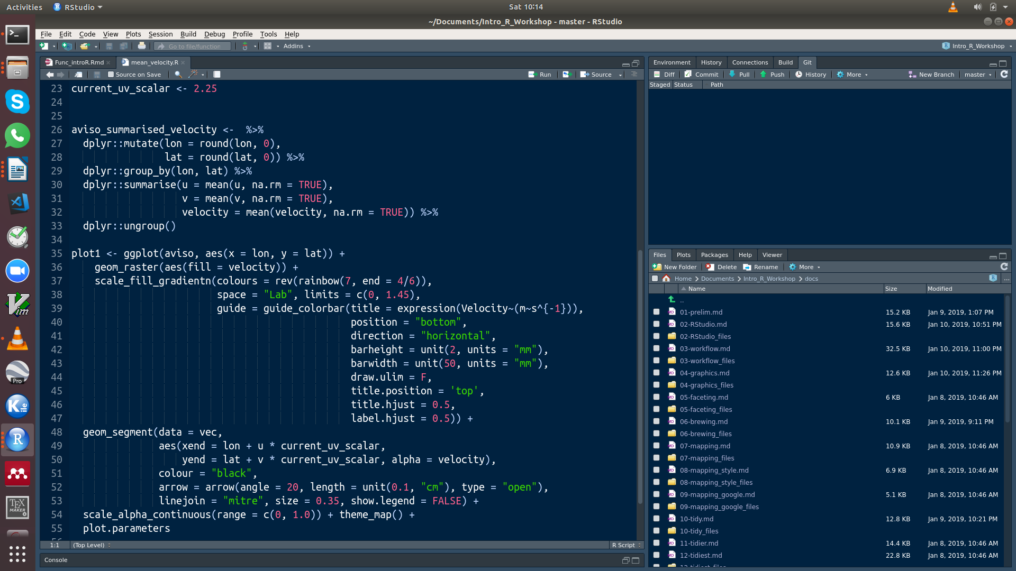

Detecting marine heatwaves (MHWs)
Presenter: Amieroh Abrahams
Supervisor: Prof. AJ Smit and Dr Robert Schlegel
University of the Western Cape
Department of Biodiversity and Conservation Biology
Notes:
1

Slide 2
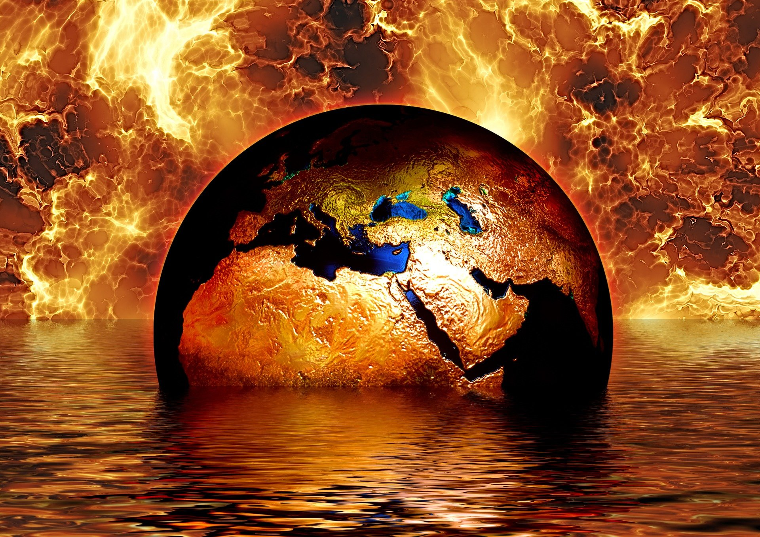
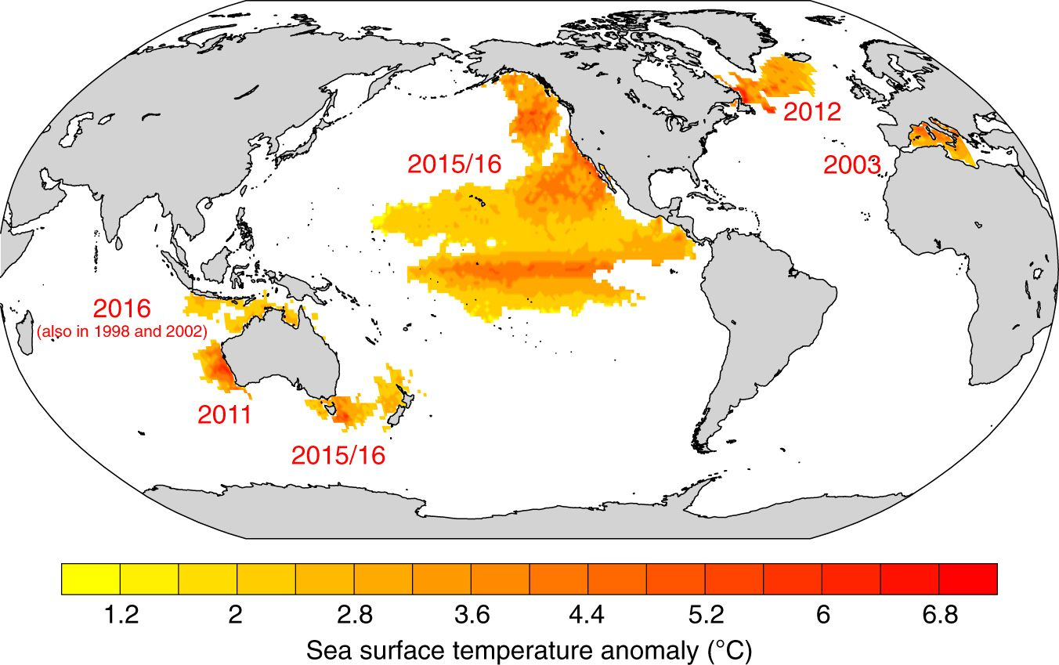
Introduction
Anthropogenically mediated warming
Climate change, a general long-term rise in mean surface temperatures
During 2015/16 one quarter of the ocean experienced a MHW
Notes:
2

Slide 3

Introduction
A marine heatwave (MHW) is defined as a discrete prolonged anomalously warm water event
MHWs have set metrics used to describe their properties, these are:
- Duration
- Mean intensity
- Maximum intensity
- Cumulative intensity
Notes:
3

Slide 4
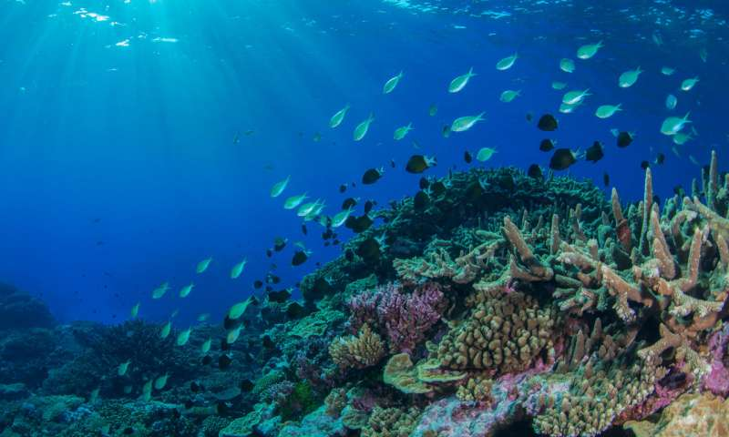
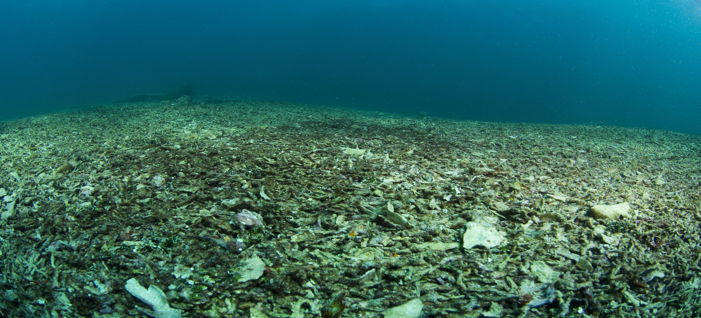
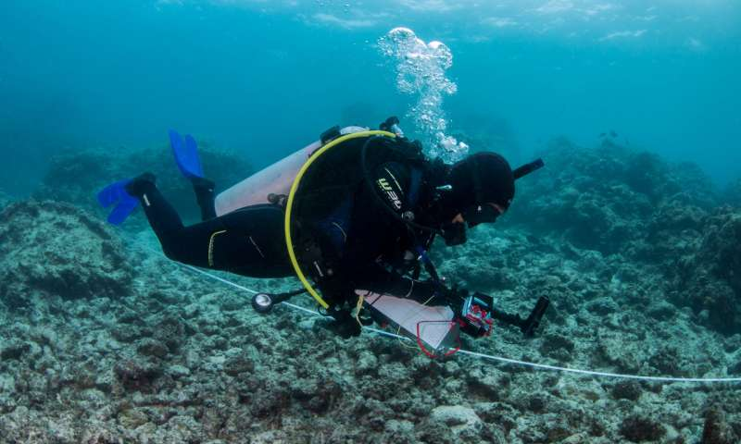
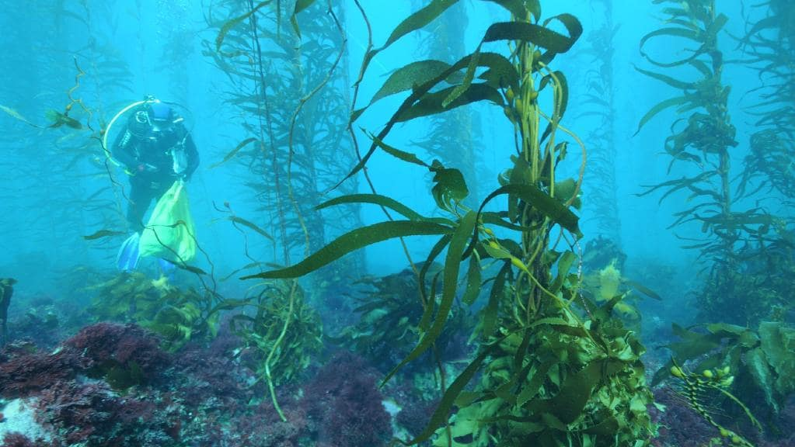
Consequences of marine heatwaves
Notes:
.
4

Slide 5
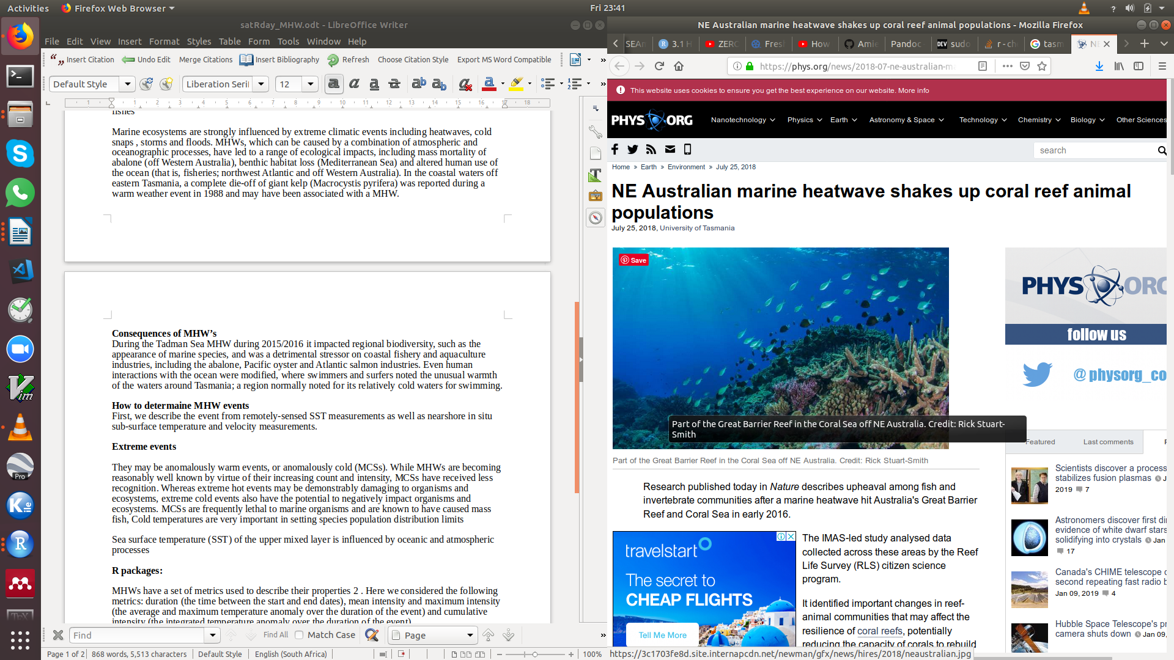
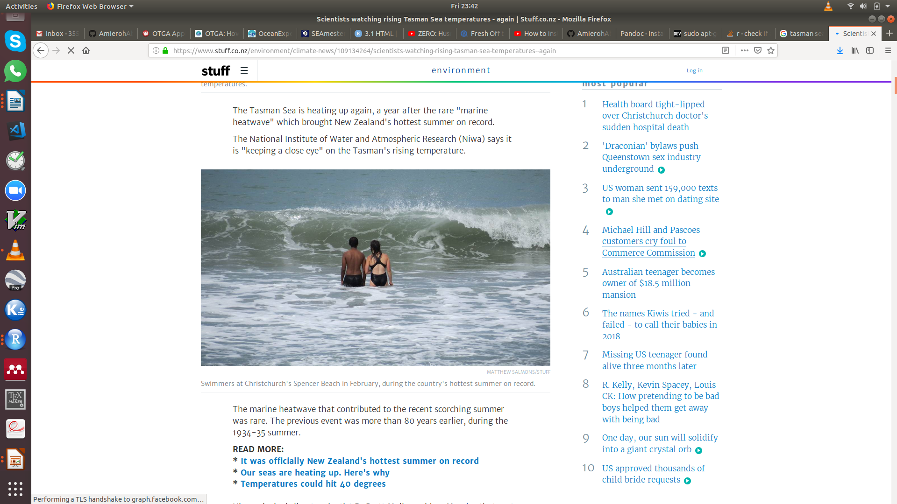
Consequences of marine heatwaves
Notes:
.
5

Slide 6
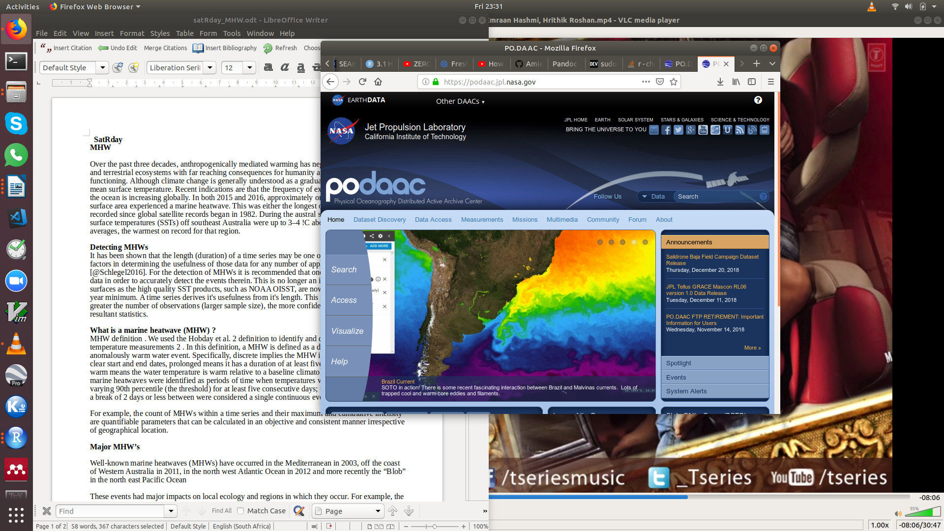
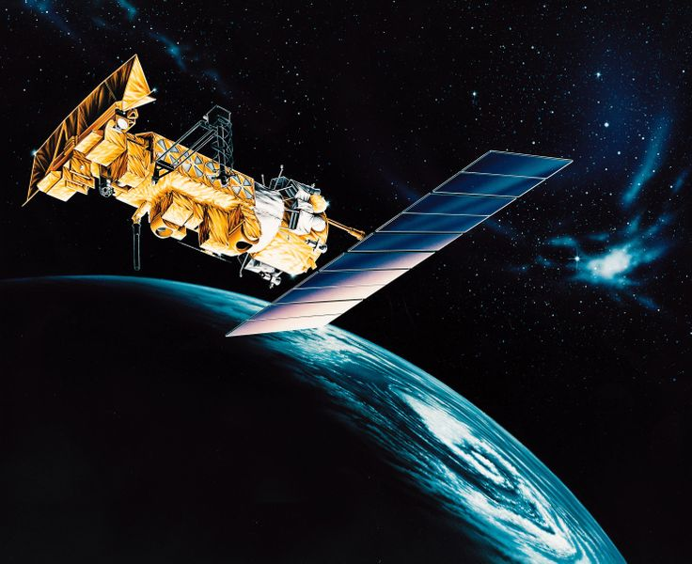
Detecting MHWs
Duration (length) of a time series
For the detection of MHWs it is recommended that one has at least 30 years of data in order to accurately detect events
Satellite SST production
Notes:
Sactn data consist of satellite-derived SST and in situ derived sst
6

Slide 7
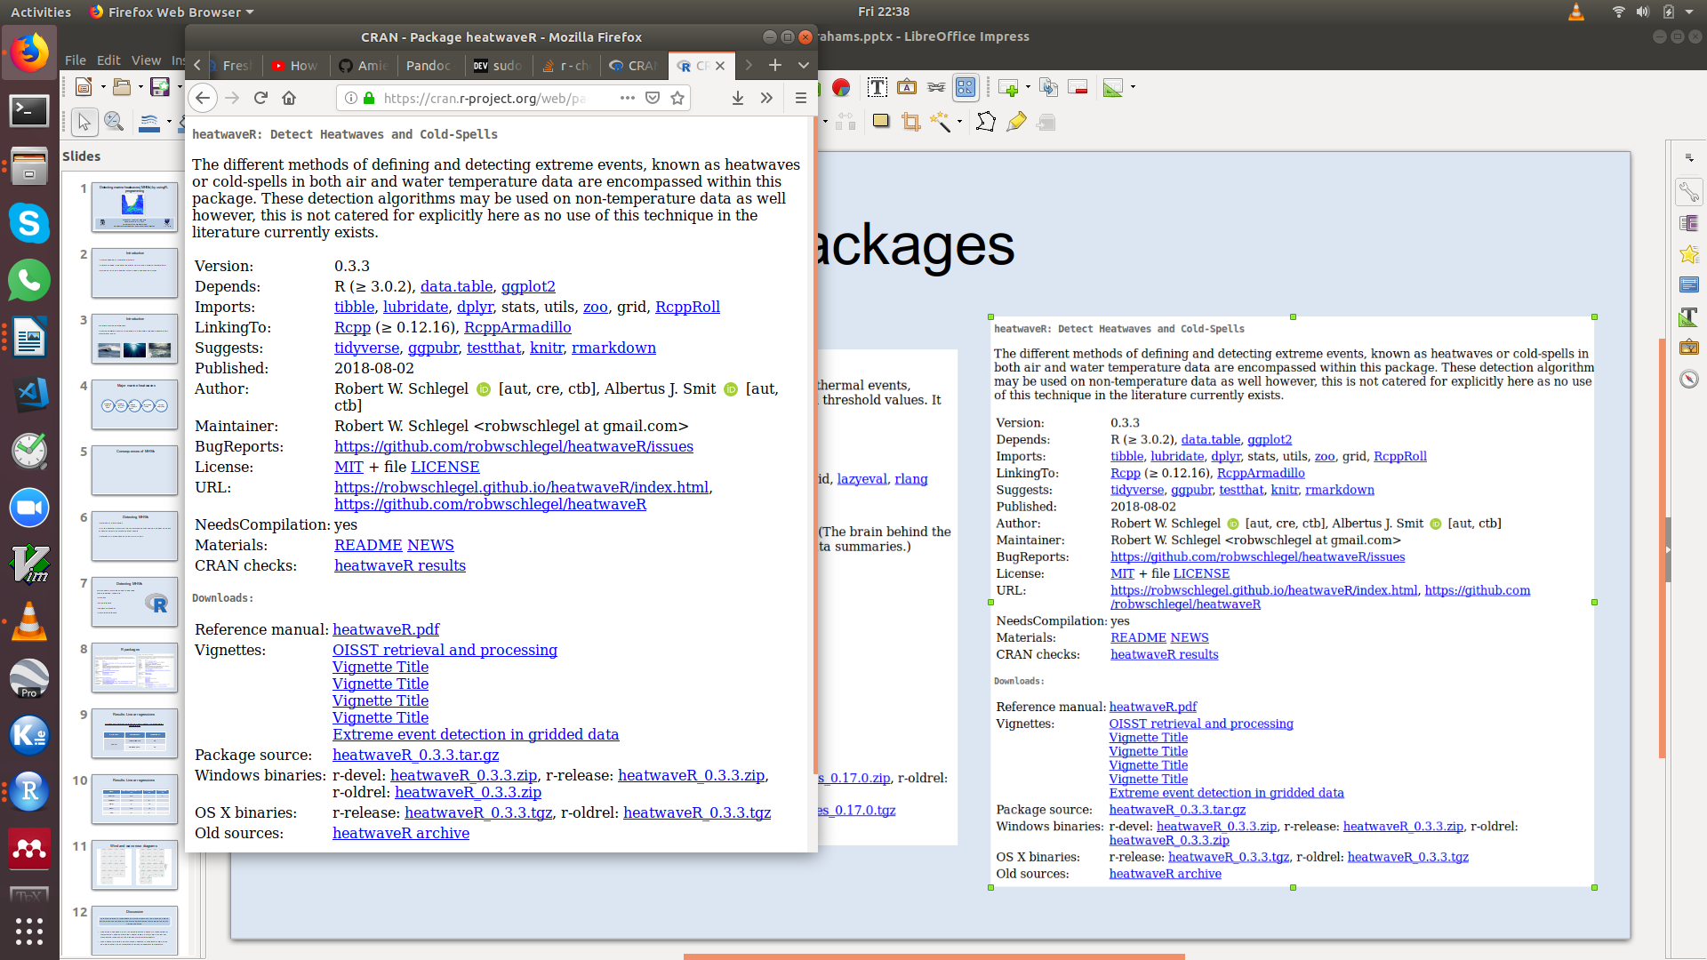
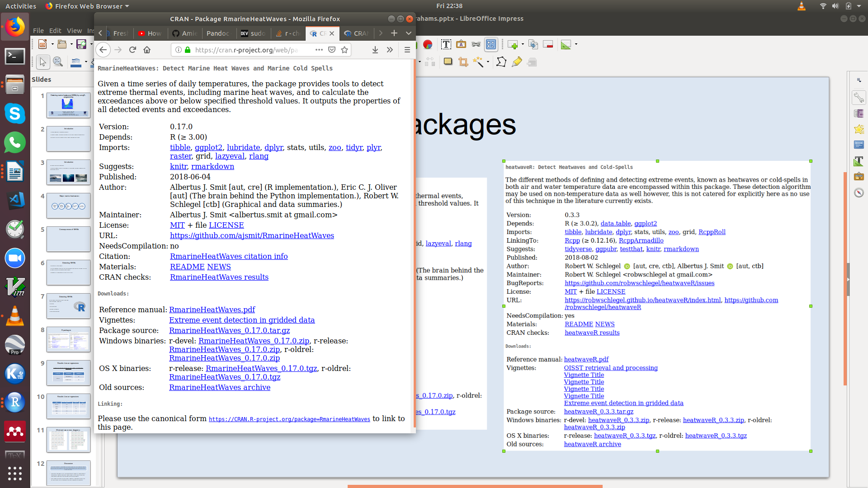
R Packages
Notes:
.
7

Slide 8
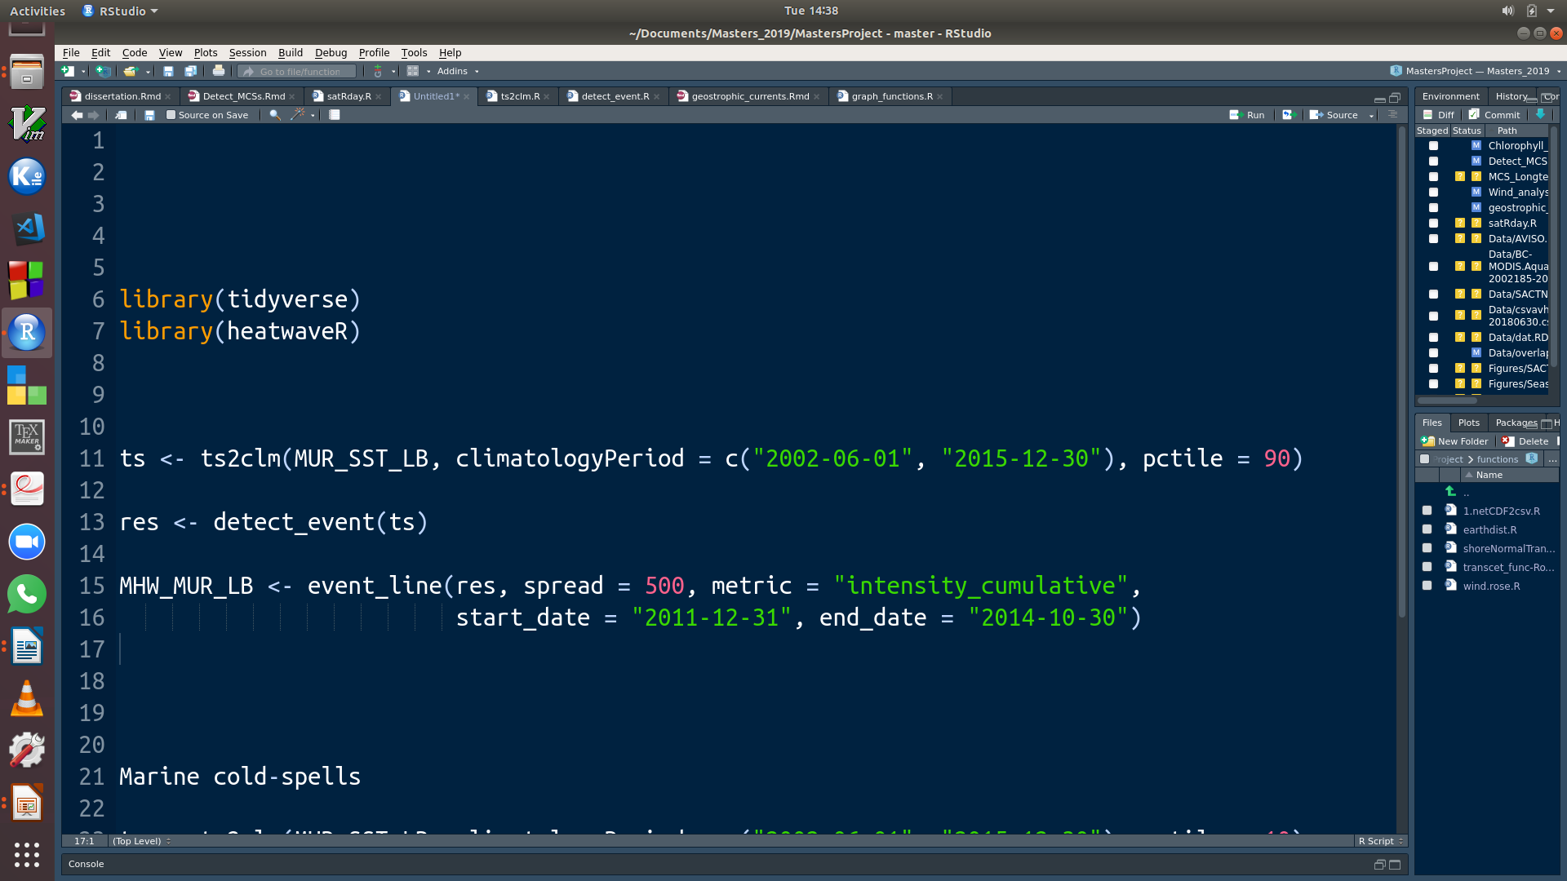
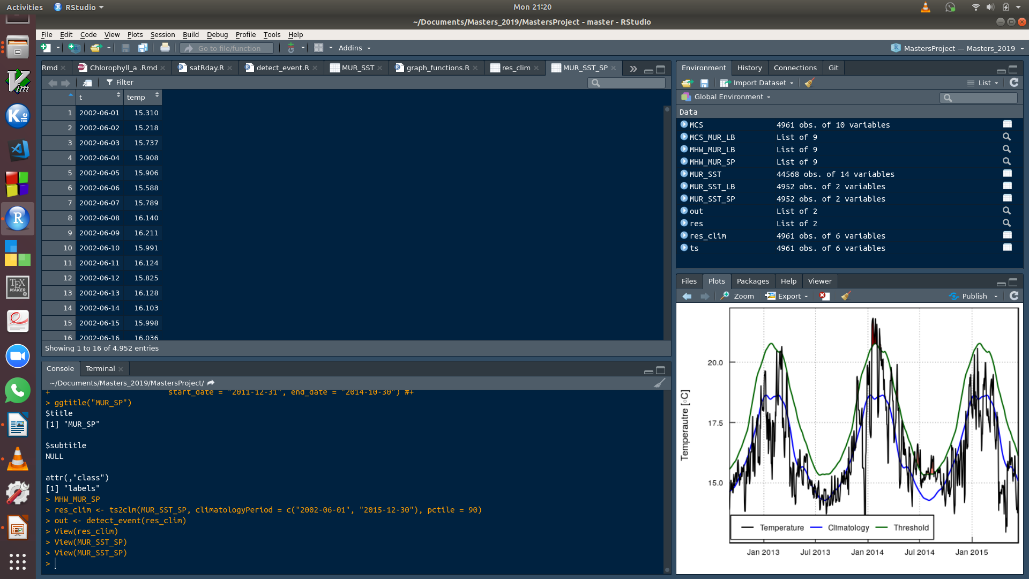
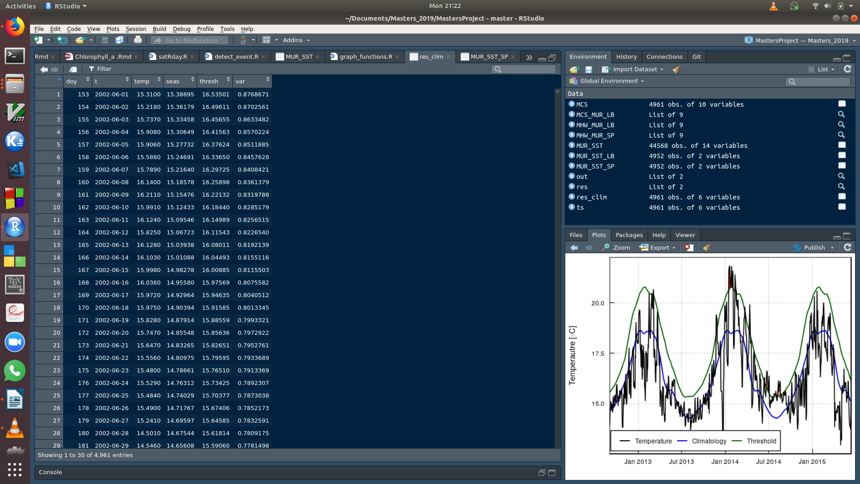
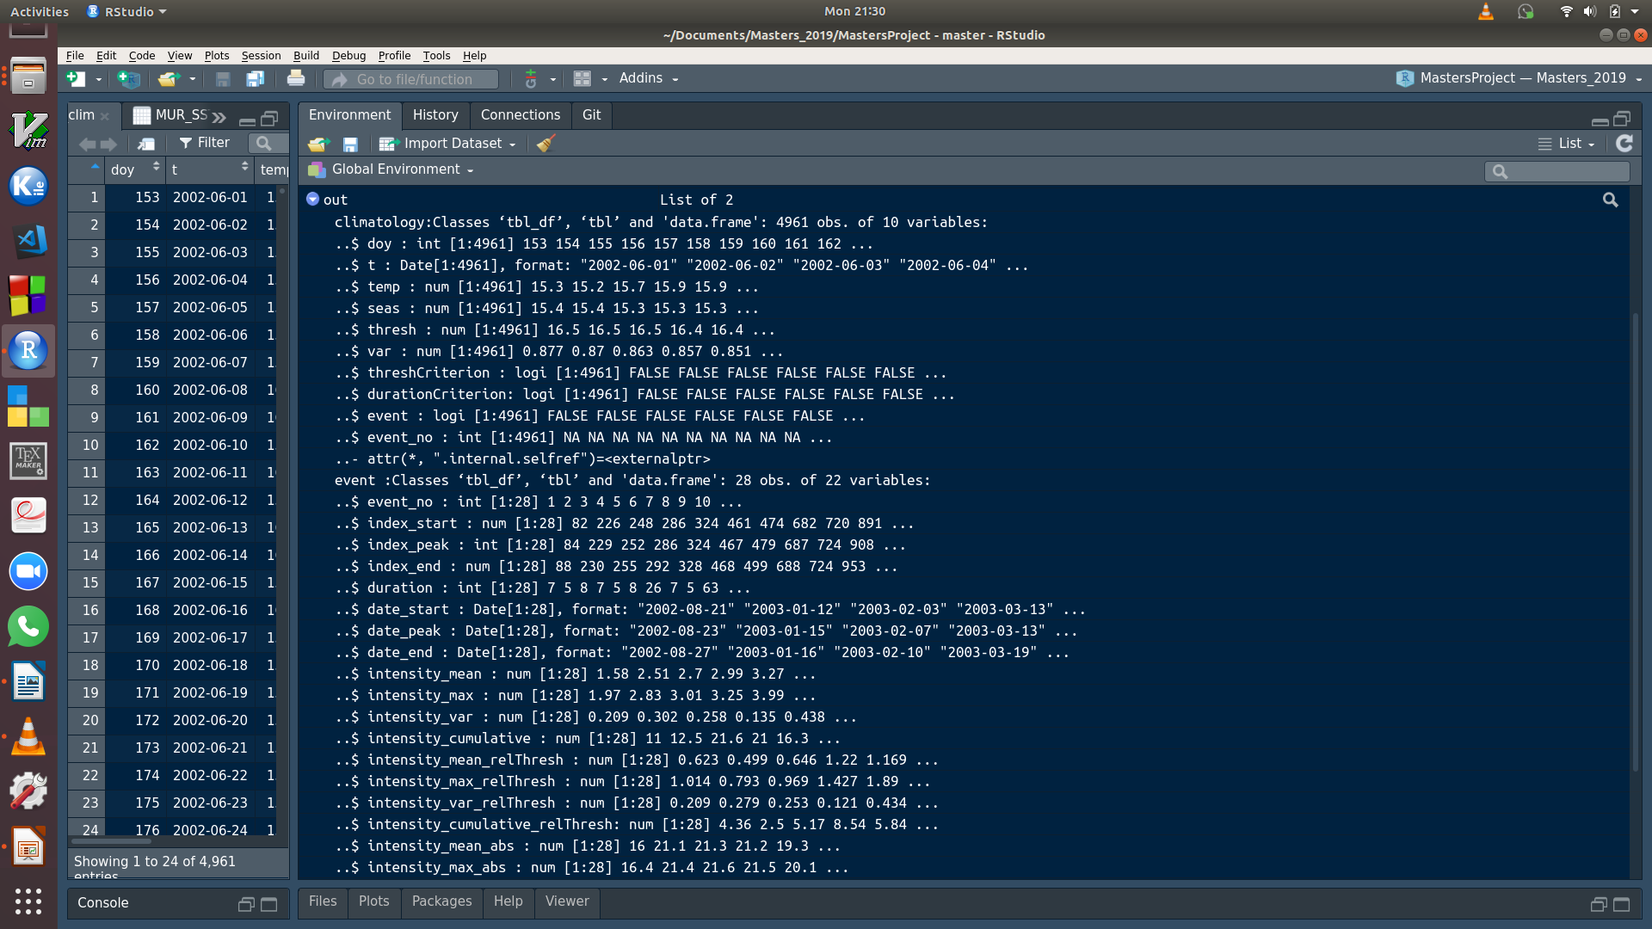
Notes:
One year focus year was selected which is the year 2005 and three of the 8 sites were chosen. These three sites were chosen to show how the temperature varies along each coast.
Hout bay – West coast
Ballito – East coast
Mossel bay- south coast
Now inorder to test whether various temperature is affected by environmental factors we will be working with wave data, wind data, air sea temperature data
8

Slide 9
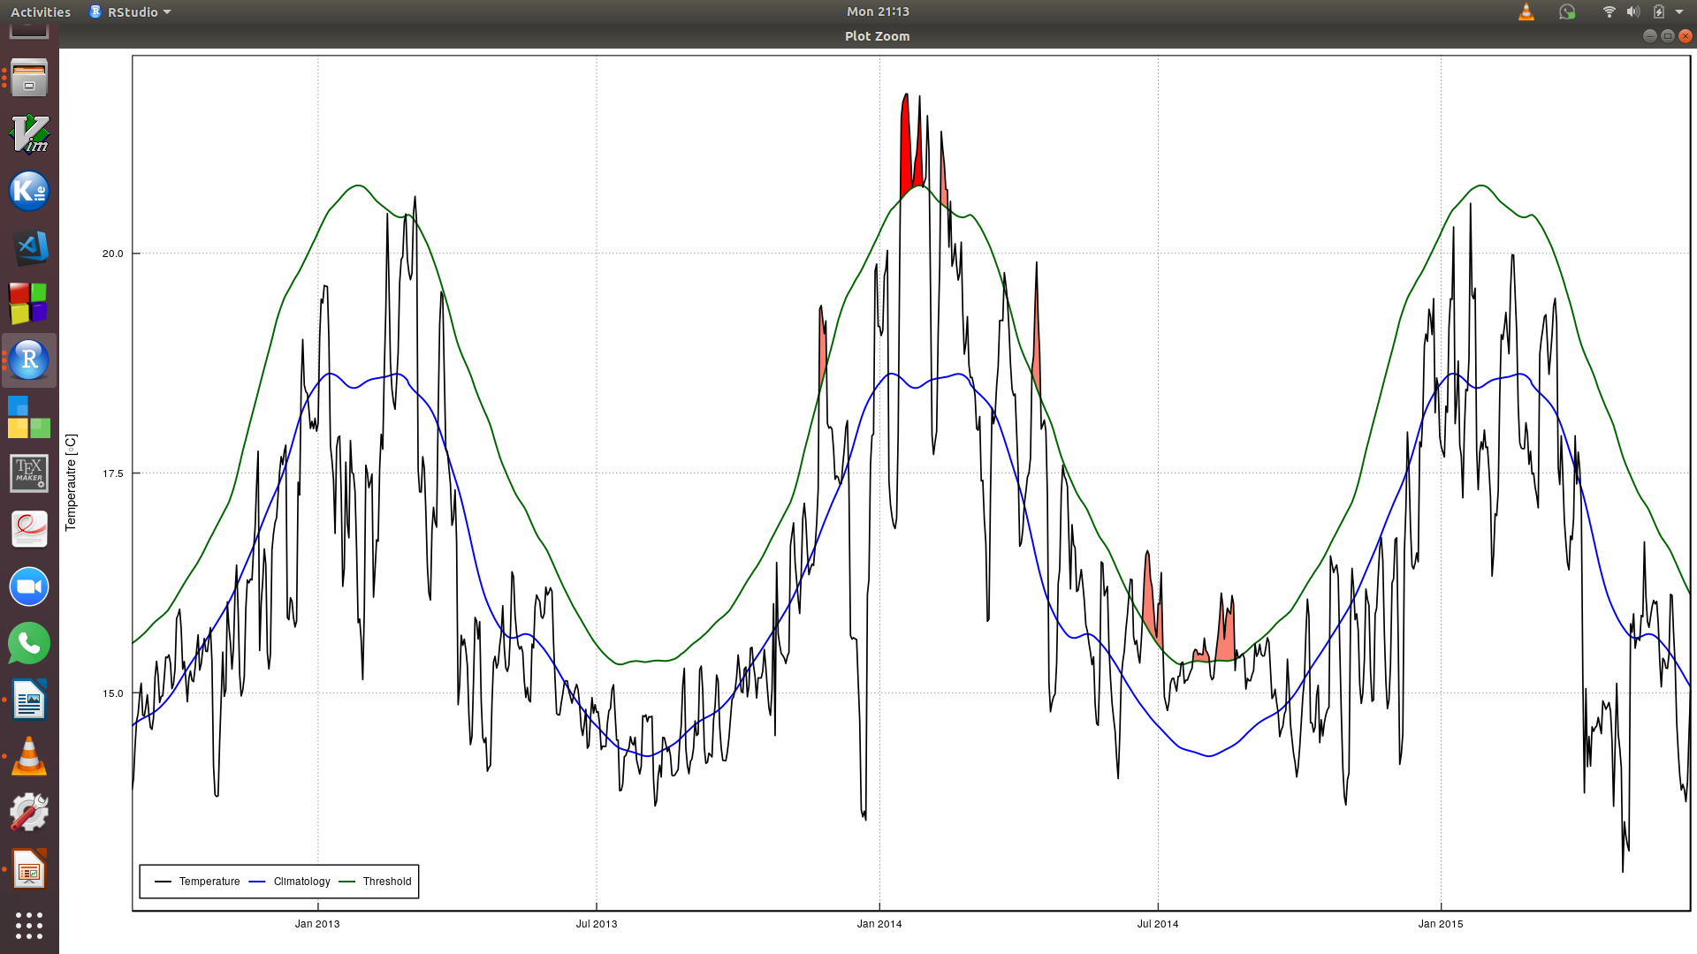
Visualisations
Notes:
One year focus year was selected which is the year 2005 and three of the 8 sites were chosen. These three sites were chosen to show how the temperature varies along each coast.
Hout bay – West coast
Ballito – East coast
Mossel bay- south coast
Now inorder to test whether various temperature is affected by environmental factors we will be working with wave data, wind data, air sea temperature data
9

Slide 10
References
Hobday, A. J., Alexander, L. V., Perkins, S. E., Smale, D. A., Straub, S. C., Oliver, E. C., Benthuysen, J. A., Burrows, M. T., Donat, M. G., Feng, M., Holbrook, N. J., Moore, P. J., Scannell, H. A.,Sen Gupta, A., Wernberg, T., 2016. A hierarchical approach to defining marine heatwaves.Progress in Oceanography 141, 227–238.
Hoegh-Guldberg, O., Mumby, P. J., Hooten, A. J., Steneck, R. S., Greenfield, P., Gomez, E.,
Harvell, C. D., Sale, P. F., Edwards, A. J., Caldeira, K., Knowlton, N., Eakin, C. M., Iglesias-
Prieto, R., Muthiga, N., Bradbury, R. H., Dubi, A., Hatziolos, M. E., 2007. Coral Reefs Under
Rapid Climate Change and Ocean Acidification. Science 318 (5857), 1737–1742.
Notes:
One year focus year was selected which is the year 2005 and three of the 8 sites were chosen. These three sites were chosen to show how the temperature varies along each coast.
Hout bay – West coast
Ballito – East coast
Mossel bay- south coast
Now inorder to test whether various temperature is affected by environmental factors we will be working with wave data, wind data, air sea temperature data
10

